Slide 1

KPI Report
[Level 1] by [Level 2]
Data from [Start Date] – [End Date]

Slide 2
Level 1 KPI Tree
[Level 1] KPI Tree and YoY Change

Slide 3
Brand Tree: Level 1 Value Sales
COCA-COLA SALES
$12.3MM (+1.2%)
TOTAL HHs
12.3MM (+1.2%)
HH PENETRATION
12% (+1.2 pp)
REPEAT RATE
12.3% (+1.2 pp)
PURCHASE FREQ.
1.2 (+1.2%)
SPEND PER TRIP
$1.2 (+1.2%)
UNITS PER TRIP
1.2 (+1.2%)
SPEND PER UNIT
$1.2 (+1.2%)
BUY RATE (SPEND)
$12.3 (+1.2%)

Slide 4
Brand Tree: Level 1 Volume Sales
COCA-COLA SALES
12.3MM kg (+1.2%)
TOTAL HHs
12.3MM (+1.2%)
HH PENETRATION
12% (+1.2 pp)
REPEAT RATE
12.3% (+1.2 pp)
PURCHASE FREQ.
1.2 (+1.2%)
VOL PER TRIP
1.2 kg (+1.2%)
UNITS PER TRIP
1.2 (+1.2%)
VOL PER UNIT
1.2 kg (+1.2%)
BUY RATE
12.3 kg (+1.2%)

Slide 5
Level 1 KPIs
[Level 1] KPIs by [Time Period]

Slide 6
[Metric] Over Time: [Level 1] [Level 1 Name]

Slide 7
Level 2 KPIs
[Level 2] KPI Summary

Slide 8
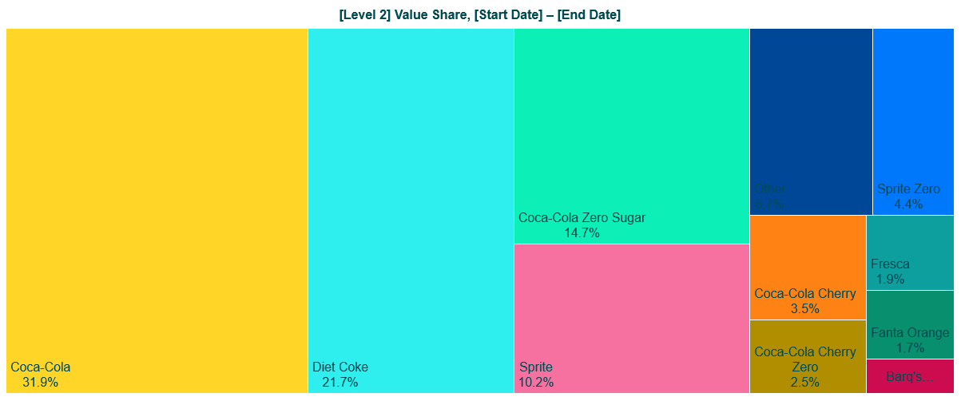
Value Share Comparison: [Level 2]

Slide 9

Volume Share Comparison: [Level 2]

Slide 10
Level 2 KPIs
Top 10 [Level 2] KPIs by [Period]

Slide 11
Top 10 [Level 2 Name]s KPI Summary and Change
 | TOTAL SALES (VALUE) | TOTAL HHS | HH PENETRATION | REPEAT RATE | BUY RATE (SPEND) | PURCHASE FREQUENCY | SPEND PER TRIP | UNITS PER TRIP | SPEND PER UNIT
LEVEL 1 | $ (+/-%) | # (+/-%) | % (+/- pp) | % (+/- pp) | $ (+/-%) | # (+/-%) | $ (+/-%) | # (+/-%) | $ (+/-%)
LEVEL 2 | $ (+/-%) | # (+/-%) | % (+/- pp) | % (+/- pp) | $ (+/-%) | # (+/-%) | $ (+/-%) | # (+/-%) | $ (+/-%)
LEVEL 2 | $ (+/-%) | # (+/-%) | % (+/- pp) | % (+/- pp) | $ (+/-%) | # (+/-%) | $ (+/-%) | # (+/-%) | $ (+/-%)
LEVEL 2 | $ (+/-%) | # (+/-%) | % (+/- pp) | % (+/- pp) | $ (+/-%) | # (+/-%) | $ (+/-%) | # (+/-%) | $ (+/-%)
LEVEL 2 | $ (+/-%) | # (+/-%) | % (+/- pp) | % (+/- pp) | $ (+/-%) | # (+/-%) | $ (+/-%) | # (+/-%) | $ (+/-%)
LEVEL 2 | $ (+/-%) | # (+/-%) | % (+/- pp) | % (+/- pp) | $ (+/-%) | # (+/-%) | $ (+/-%) | # (+/-%) | $ (+/-%)
LEVEL 2 | $ (+/-%) | # (+/-%) | % (+/- pp) | % (+/- pp) | $ (+/-%) | # (+/-%) | $ (+/-%) | # (+/-%) | $ (+/-%)
LEVEL 2 | $ (+/-%) | # (+/-%) | % (+/- pp) | % (+/- pp) | $ (+/-%) | # (+/-%) | $ (+/-%) | # (+/-%) | $ (+/-%)
LEVEL 2 | $ (+/-%) | # (+/-%) | % (+/- pp) | % (+/- pp) | $ (+/-%) | # (+/-%) | $ (+/-%) | # (+/-%) | $ (+/-%)
LEVEL 2 | $ (+/-%) | # (+/-%) | % (+/- pp) | % (+/- pp) | $ (+/-%) | # (+/-%) | $ (+/-%) | # (+/-%) | $ (+/-%)
LEVEL 2 | $ (+/-%) | # (+/-%) | % (+/- pp) | % (+/- pp) | $ (+/-%) | # (+/-%) | $ (+/-%) | # (+/-%) | $ (+/-%)

Slide 12
[Metric] Over Time: Level 2, Top 10 [Level 2 Name]

Slide 13
Conclusions
Summary of conclusions and recommendations for a CPG company based on the associated data
Conclusions
Drivers of trends
Outliers that are large enough to mitigate trends or cause countertrends for certain subsets
Recommendations - Actions that a CPG organization could take, for example…
Re-evaluate a product that isn’t doing well
Refocus messaging on an attribute that has a lot of growing items (e.g. zero sugar or high protein SKUs)
Distribution in a retailer that is strong for a competitor but not for the focus brand

